Slide 1

Kaggle Challenge
A case of Banking Client
Author: Tam NGUYEN

Slide 2
Table of Contents
1
Data Description
2
Data Correlation
3
Feature Selection
4
Model Performance and Selection
5
Model Improvement
6
Final Word

Slide 3
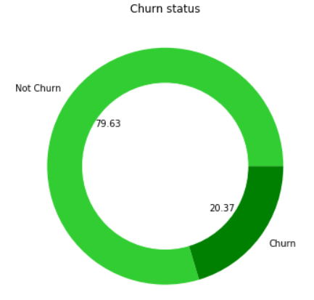
Data Description
The data contains information of 10,000 clients in a bank, including their churn status (which is a categorical variable). Out of them, there are 2037 clients that have already churned out
Statistical Description
n | 10,000
mean | 0.203700
sd | 0.402769
min | 0
max | 1
skew | 1.47139
kurtosis | 0.164988
There are 413 clients having tenure length equal zero while the balance amount is different from zero. So, the missing value might be encoded as ‘zero’ in this case
We would exclude these clients and the variable IsActiveMember from the model.
IsActiveMember is a subjective record

Slide 4
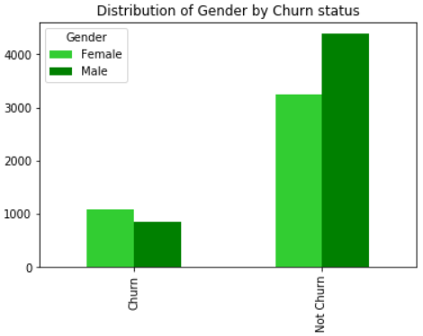
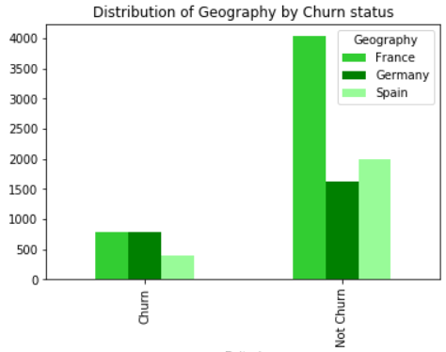
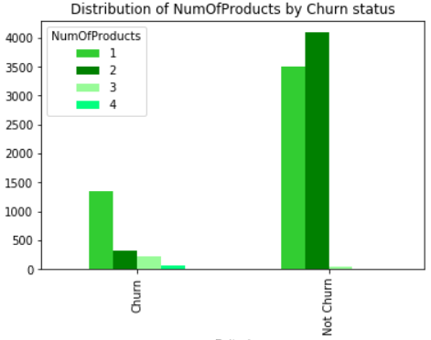
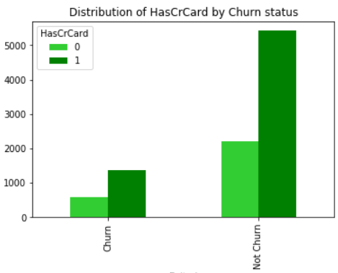
Data Description (cont.)
Most of exited clients are female while male clients tend to stay back.
The majority of non-churn clients are from France. The number of churn clients from Germany and Spain is fairly the same as French clients.
The distribution of HasCrCard in both Group is the same
Client uses one two products tend to stay back. Clients that use more than that might have more motivation to exit
Gender, Geography and NumOfProducts might effect significantly customer behavior

Slide 5
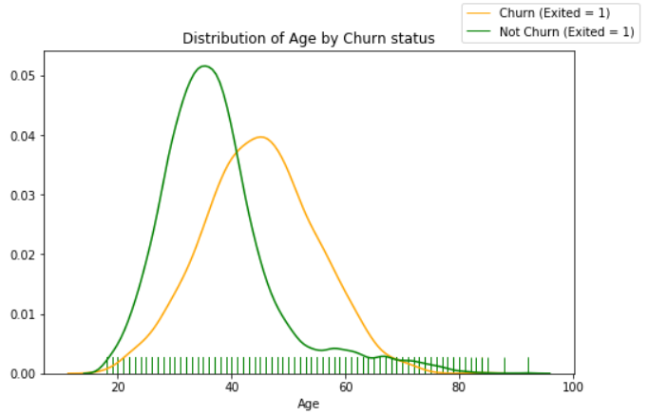
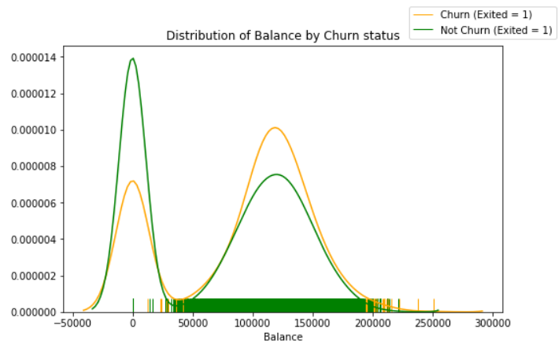
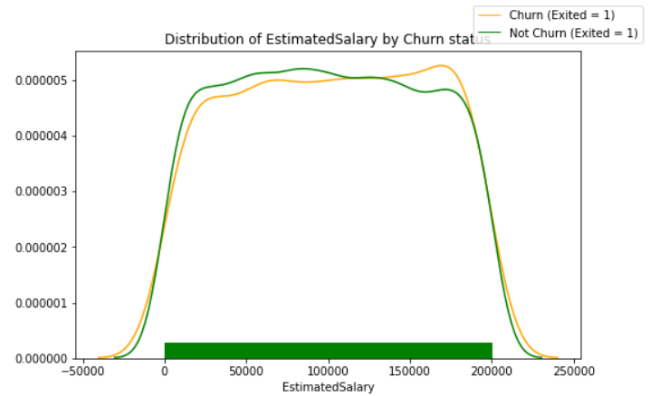
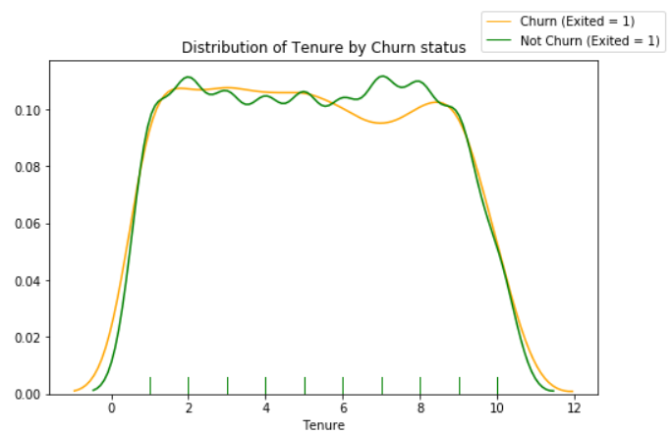
Data Description (cont.)
The distribution of Tenure or EstimatedSalary between Churn and Not-Churn group are not different
Age and Balance might effect significantly customer behavior
The Churn group seems to have higher Balance bank amount than the counterpart.
The older age the client get, the more inclination of churning it is.

Slide 6
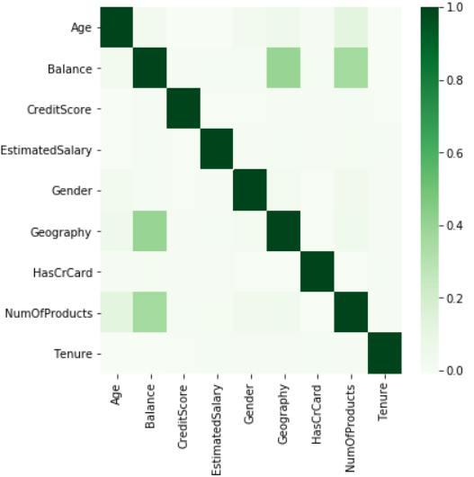
Data Correlation
Between categorical variables, the correlation coefficient is measured by applying Cramer statistics (*)
Between continuous variables, the correlation coefficient is measured by applying Pearson Correlation Coefficient
Between continuous and categorical variables, the correlation coefficient is measured by applying Correlation ratio (**)
Result: No significant correlation is detected
(*) https://en.wikipedia.org/wiki/Cram%C3%A9r%27s_V
(**) https://en.wikipedia.org/wiki/Correlation_ratio

Slide 7
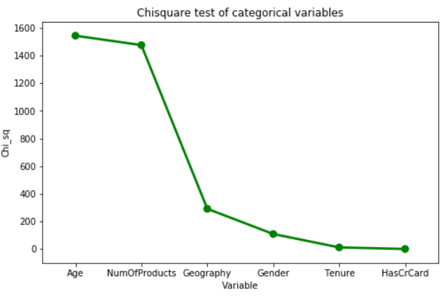
Feature Selection
We discretize variable “Age’ and ‘Tenure’ beforehand
Feature Selection is for categorical variables as there are only two continuous variables: “Balance’ and ‘EstimatedSalary’
From the graph, we would exclude variable ‘Tenure’ and ‘HasCrCard’ because of low chi square value
"Age" and "NumOfProducts" have highest chi square value which indicates the most important variables

Slide 8
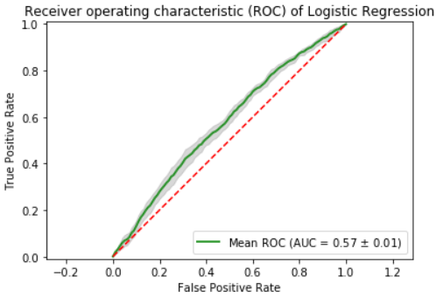
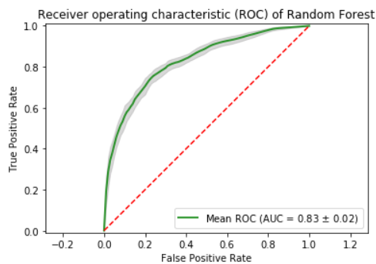
Model Performance and Selection
We built the models based on two classical alogrithms: “Logistic Regression’ and ‘Random Forest’
We applied cross validation (10 folds) to avoid over-fitting
 | Logistic Regression | Random Forest
Precision score | 0 | 0.663018
Recall score | 0 | 0.452026
F1 score | 0 | 0.537559
Accuracy | 0.795687 | 0.841102
Logistic model gives poor result (it predicts all clients would not churn out) ending in poor AUC and lower metrics performance values. So Random Forest is a better model than Logistic regression in this case.

Slide 9
Model Improvement
What to do to improve the model?
1
Adding outlier detection process
2
Creating a pipeline including Feature Selection process
3
Testing more combination of variables
4
Hyperparameter Tunning
5
Trying other alogrithms including Gradient Boosting
6
Adding more performance criteria including: Lift Chart, Gain Chart, KS Statistics

Slide 10
Final Word
Thank you for your consideration!

